Slide 1

Menopause
Amy Armiger
Trainee Advanced Clinical Practitioner/Lead Nurse

Slide 2

Learning Outcomes
What is the menopause
Symptoms
Self helps & Alternative therapies
Hormonal/non-hormonal treatments
Weighing up pro’s and con’s
Long term expectations

Slide 3

What is the menopause
Menopause = Menstruation (periods) stops
Average age is 51(UK)
All women experience the menopause
Menopause can occur earlier if the ovaries are damaged by treatment such as chemotherapy/ radiotherapy, or surgically removed
8 out 10 women have symptoms

Slide 4
Stages of menopause
Pre-menopause – begins at puberty and lasts until women enters menopausal transition
Peri-menopause – ovaries start to decrease/ fluctuate in hormone production, and can cause symptoms
Menopausal phase – the end of menstruation
Post menopause – 12 months after last period

Slide 5

Additional definitions of menopause
Early menopause – between the ages 40-44
Premature Ovarian Insufficiency (POI) – menopause before the age of 40
Surgical menopause – the surgical removal of the ovaries

Slide 6
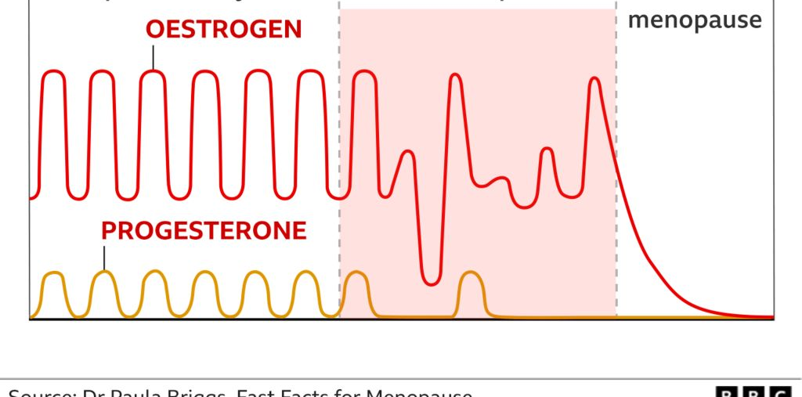

Slide 7
Testing for the menopause
Blood tests are not required after the age of 45 years of age
The tests measure levels of a hormone called FSH (follicle-stimulating hormones). However, hormone levels go up and down all the time, even during the course of a day, so the test isn’t always accurate.
Women can still get pregnant if their periods are irregular - experts advise using contraception until the age of 55

Slide 8
Symptoms
Vasomotor
Psychological
Physical
Loss of interest in sex (libido)
Hot flushes
Sweating at night
Heart beating quickly or strongly (Palpitations)
Feeling tense or nervous
Anxiety/panic attacks
Excitable
Feeling tired/ lacking in energy
Loss of interest in things
Feeling unhappy or depressed
Crying spells
Irritability
Sleeping problems
Feeling dizzy
Headaches
Muscle and joint pains
Vaginal dryness
Urinary problems
Dry itchy skin
Hair changes
Having less or no interest
Difficulty in arousal
Lack of desire
No wanting to initiate
Lack of pleasure

Slide 9
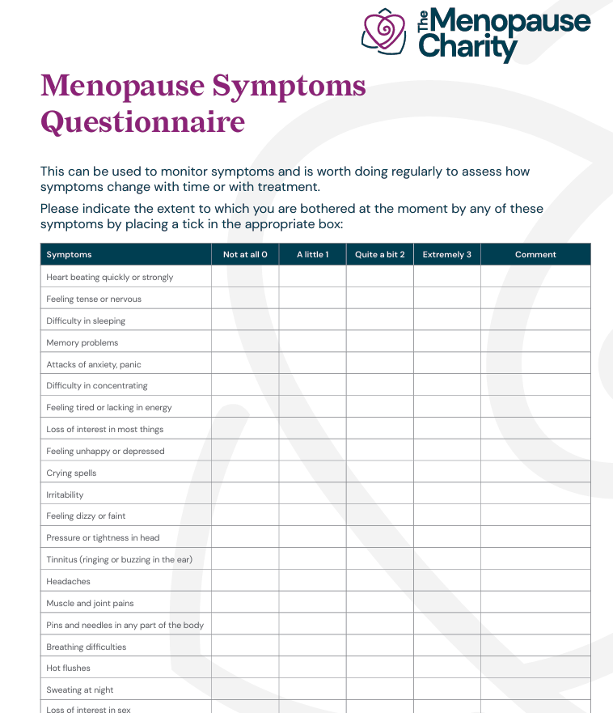

Slide 10

Self Help
Lifestyle
  Eating well – balance diet
  Healthy weight
  Reducing alcohol and caffeine
  Regular sleep routines
  Stopping smoking
  Exercise
  Reducing stress
  Pelvic floor exercises
Notes:
Nutrition is exceptionally important – keep healthily, manage weight and reduce risk of health problems, predominately natural, unprocessed foods from a variety of different food groups, With natural unprocessed foods, portions can be larger, and they keep you fuller for longer, prevents sugar and energy crashes, fluid retention, bloating, and protects you from preventable diseases.
Keeping physically active helps with weight management, improves bone strength, muscle and joint pains, and regulates the blood pressure, and reduced cholesterol. It also helps reduce the risk of CVD, T2DM and dementia and reduced risk of any early death.
Using achievable goals, start small and build up

Slide 11
Over the counter products
(Note limited evidence)
Vitamin D
Omega 3
Magnesium
Black Cohosh
Glucosamine
St Johns wort
Pure collagen
Vaginal moisturisers/ lubricants
Notes:
Black Cososh – A member of the buttercup family, it grows in the woodlands of the eastern United States and Canada.
There is some evidence that isoflavones and black cohosh may relieve vasomotor symptoms, but the quality, purity, constituents, and safety of these products may be unknown, and different preparations may vary.
St Johns wart- Some women have found St John's wort can reduce their hot flushes and night sweats during menopause. However, the ingredients of products containing St John's wort may vary and their effects are uncertain. Also, these products can interfere with other drugs, including those used to treat breast cancer (for example, tamoxifen)

Slide 12

Holistic approaches
(Limited Evidence)
Acupuncture
Aromatherapy
Breathing/ meditations techniques
Reflexology
Pilates/yoga/ tai chi
Cold water swimming
CBT
Notes:
Acupuncture - The Danish study found that five weeks of acupuncture in women with menopausal symptoms reduced hot flushes, night sweats, sleep disturbances and emotional problems, though were unable to identify the underlying mechanism behind this nor determine how much was placebo effect. Though few s/e reported – EVBP limited.
Aromatherapy – Limited EVBP
Clary sage – could help with hot flushes,
Peppermint oil – Hot flushes and cramping
Lavender – promote feelings of relaxation, may balance hormones, and good for soothing perianal discomfort
Geranium – Stress relief, anxiety and dry skin
Basil – increase oestrogen levels and improve your mood
Citrus – fewer physical sx, and helped with sexual desire, decrease BP and improve oestrogen levels – makes skin sensitive to sun.
Cold water swimming – study showed notably helped with sx such as anxiety, mood swings, irritability, low mood and hot flushes. Calming and mood busting effects.

Slide 13

Hormone Replacement Therapy
A treatment used to help menopause symptoms by replacing oestrogen and progesterone.
Oestrogen:
Conjugated
Oestradiol
Oestrone/Oestriol
Progesterone:
C19 – Norethisterone, levonorgestrel, Norgestrel
C21 – Medroxyprogesterone Acetate (Provera), Dydrogesterone
Natural progesterone – Utrogesterone
Notes:
Estrone (E1) is the primary form of estrogen that your body makes after menopause.
Estradiol (E2) is the primary form of estrogen in your body during your reproductive years. It’s the most potent form of estrogen.
Estriol (E3) is the primary form of estrogen during pregnancy.
Conjugated Oestrogens
Equine estrogens: Obtained from pregnant mares (horses) urine. No usually prescribe but available as premarin or premique. Most VTE risk data comes from studies using this, suggesting a class risk effect
Synthetic hormones: 100% synthesised, manmade eg tibolone, progestogens
Natural body-identical hormones: Licenced hormones e.g. all estradiol preparation and Utrogestan. Base molecule derived from either soy or yams and modified to be identical to ovarian estradiol, progesterone or testosterone

Slide 14
Contraindications
Breast Cancer – current or past (Family history - see guidance)
Oestrogen sensitive tumour - endometrial Cancer
Blood clots/stokes/ Heart attack – Current/past
Liver Disease
Thrombophilic (Clotting)disorders
Untreated endometrial Hyperplasia

Slide 15
Cautions
Headaches/Migraines
Overweight
Smoking
Diabetes
History of bleeding problems
Increased risk of breast cancer
Porphyria cutanea tarda

Slide 16
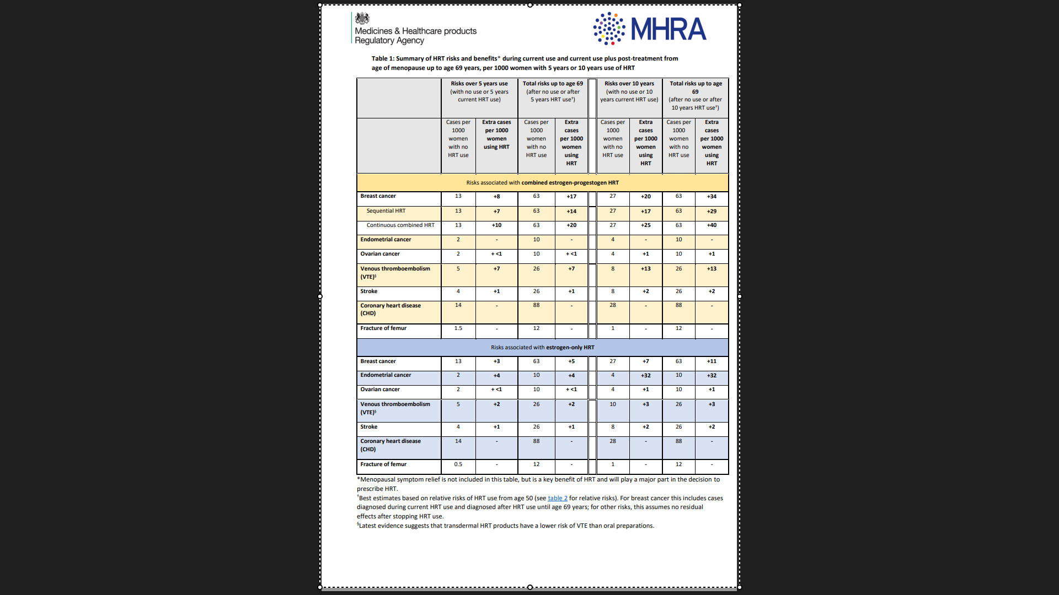

Slide 17
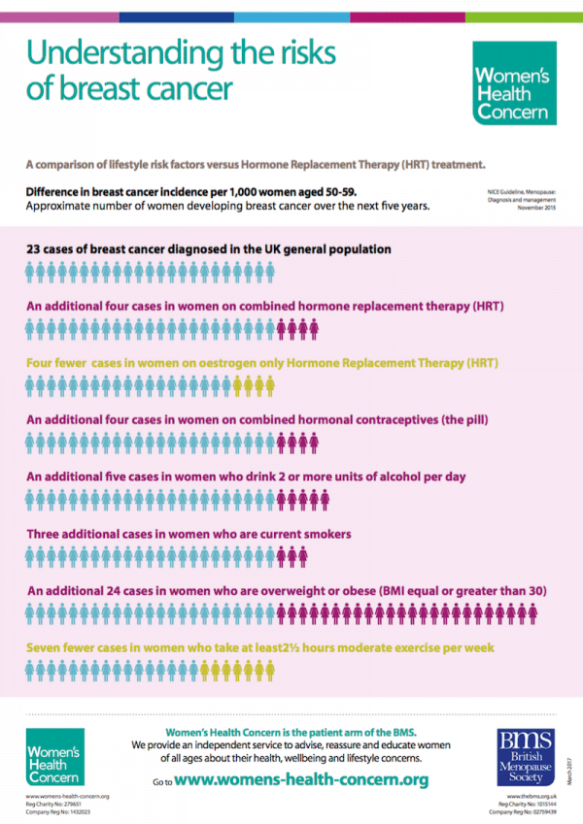

Slide 18
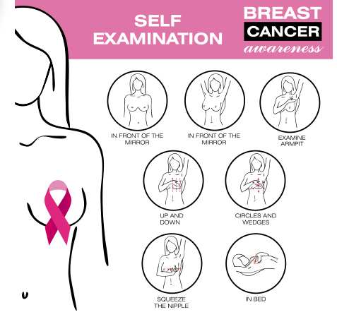
Screening
Smears
  3 yearly until age of 50
  5 Yearly until age of 65
Mammograms
  3 Yearly from 50 -71

Slide 19
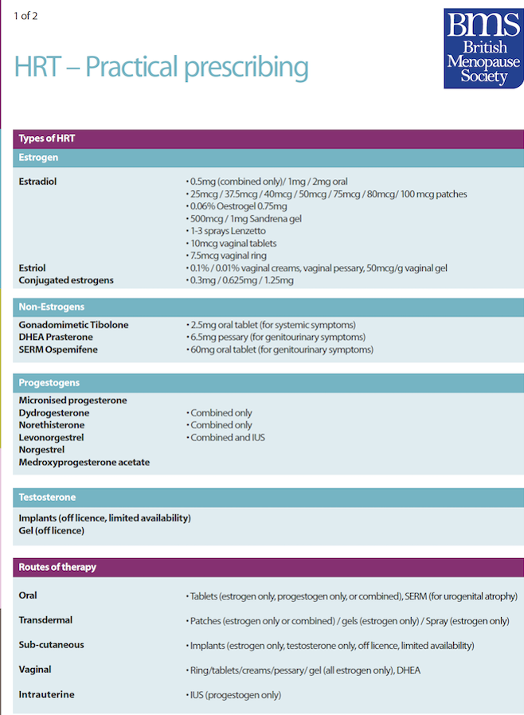
HRT regimes
Continuous combined (post menopausal)
  Oestrogen and progesterone everyday
Sequential regime (peri-menopausal)
  Oestrogen everyday, progesterone alternating (2weeks on/off)
Unopposed Oestrogen (hysterectomy)
  Ostergren only daily

Slide 20
Common Forms of HRT
Patches
- Combined
- Sequential
- Oestrogen only
Spray
- Oestrogen only
Gel Pump
- Oestrogen only
Tablets
- Combined
- Sequential
- Oestrogen only
- Progesterone only
Mirena Coil
- Progesterone only

Slide 21
Common side effects
Oestrogen
Fluid retention
Breast tenderness
Bloating
Nausea
Headaches
Progesterone -
Fluid retention
Breast tenderness
Headaches
Mood swings
PMT symptoms

Slide 22
Benefits of HRT
Symptom management
Reduce cardiovascular disease (10 year window)
Bone protection / reduce fragility fractures
Reduced risk of colorectal cancer
Reduce type II diabetes

Slide 23
Vaginal Health
Oestrogen pessaries or cream
Vaginal moisturisers
Lubrication
Pelvic Floor exercise

Slide 24
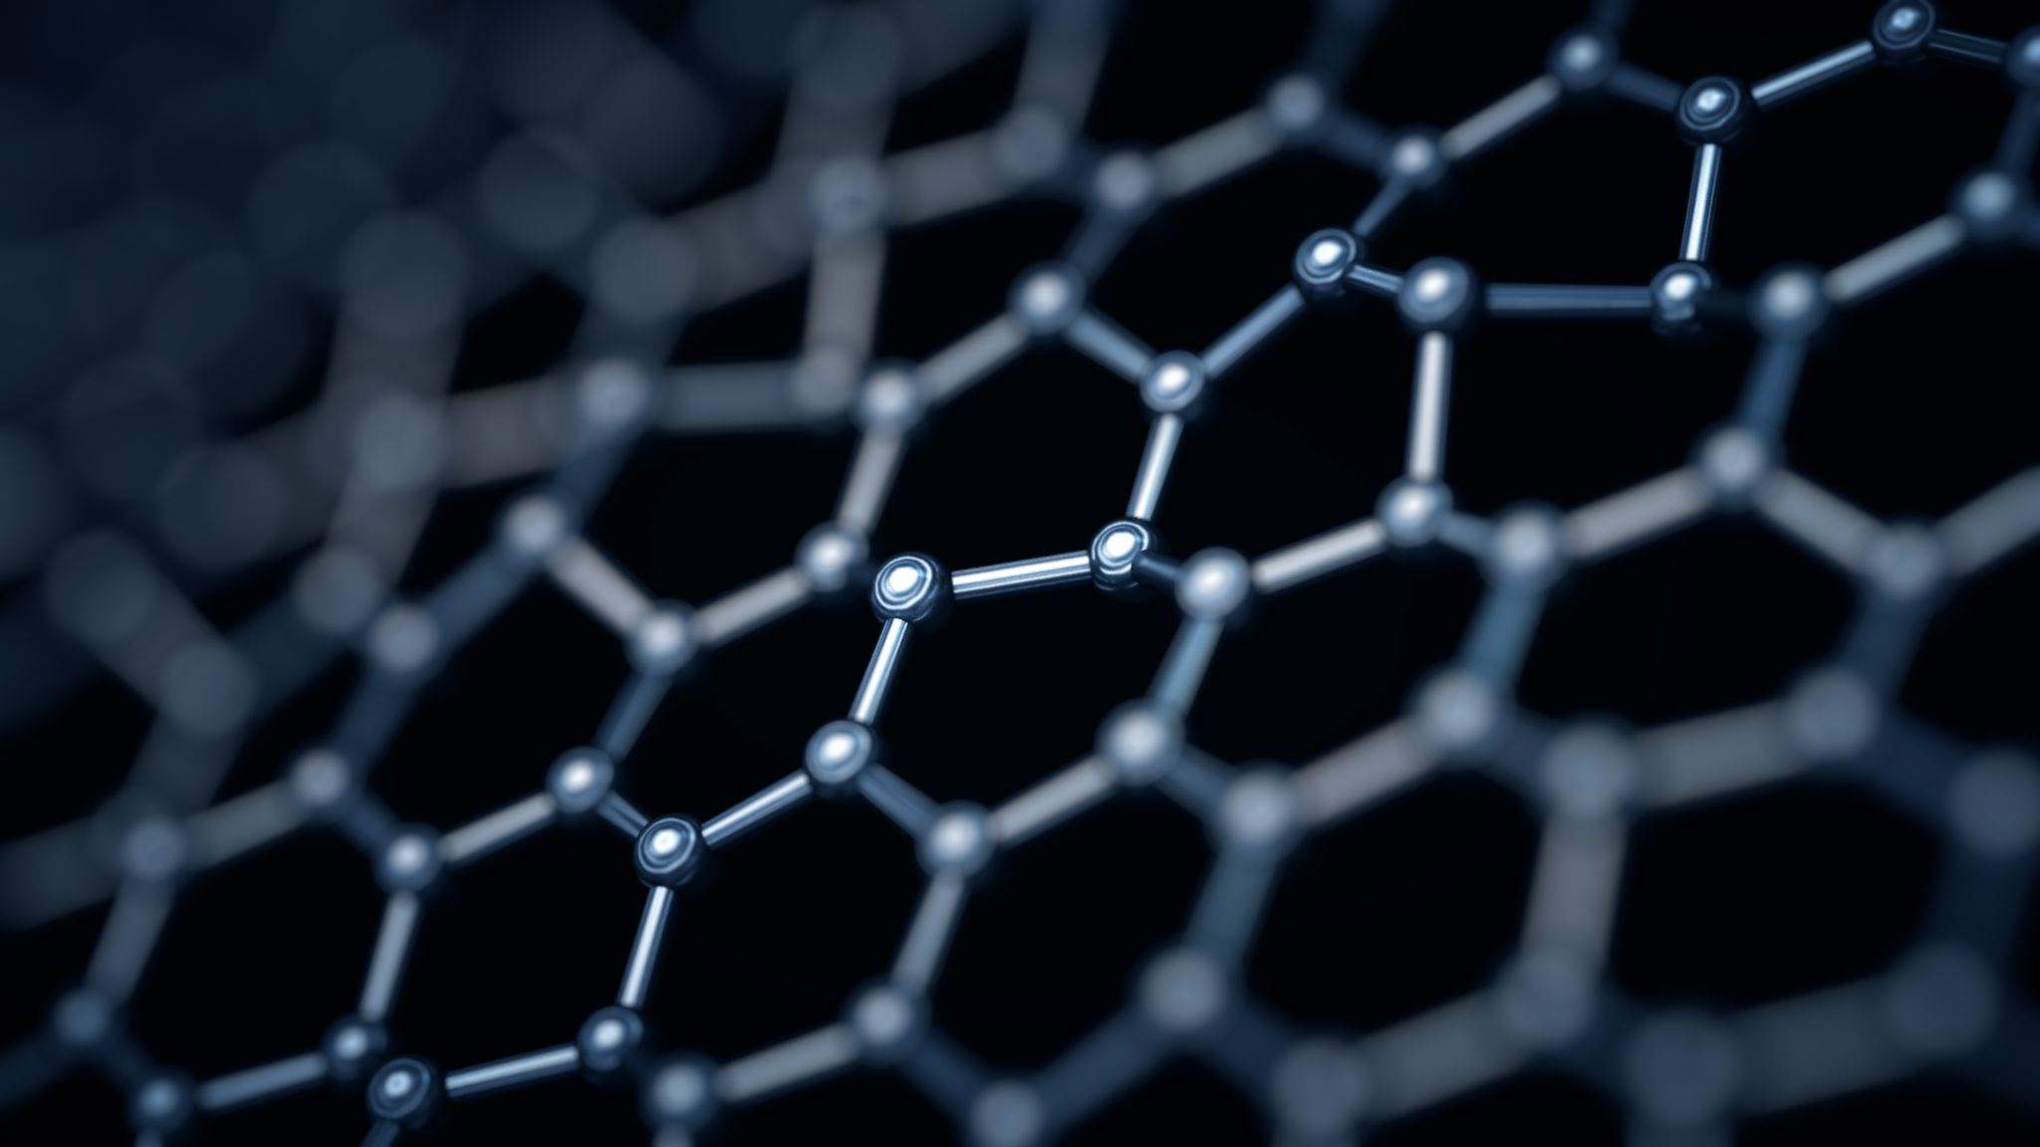
Non-Hormonal Treatments/Medications
Certain antidepressants
Clonidine
Gabapentin (off-label)
Isoflavones (soy) and black cohosh
CBT for low mood and anxiety
Notes:
Certain antidepressants -For vasomotor symptoms Options include fluoxetine (20 mg daily), citalopram (20 mg daily), paroxetine (10 mg daily), or venlafaxine modified-release (37.5 mg daily for 1 week then increased to 75 mg once daily if needed)
Clonidine – (hot flushes - improve sx in approx. 40%)
Anti-hypertensive medication
Common s/e – dizziness, irritability, nausea and dry mouth
Isoflavones (soy) and black cohosh – may help with hot flushes (vary in content and safety)
Gabapentin (off-label) - improve sleep and reduced pain. < hot flushes 50% of pts

Slide 25
Testosterone in the body
Libido
Mood and energy
Cognitive function
Menstrual cycle
Bone density
Muscle mass
Decreases body fat

Slide 26
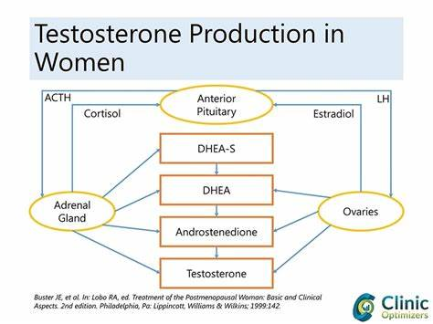
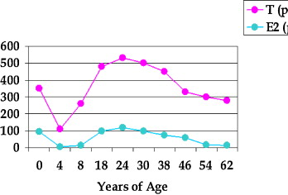
Notes:
Testosterone and the pro-androgens decline gradually with aging in both sexes. Pre and post-menopausal women, and aging men, may experience symptoms of androgen deficiency including dysphoric mood (anxiety, irritability, depression), lack of well being, physical fatigue, bone loss, muscle loss, changes in cognition, memory loss, insomnia, hot flashes, rheumatoid complaints, pain, breast pain, urinary complaints, incontinence as well as sexual dysfunction.
Many women with low systemic testosterone levels do not complain of distressing low libido or other symptoms, even on direct questioning.

Slide 27
When can testosterone be offered ?
Testosterone supplementation should only be considered in women who complain of low sexual desire.
The NICE Menopause Guideline (NG23) and the BMS recommend that a trial of conventional HRT is given before testosterone supplementation is considered.
Biopsychosocial approach has excluded other causes such as relationship, psychological and medication related HSDD e.g. SSRIs/SNRIs.

Slide 28

Testosterone Replacement
Testosterone supplementation is a recognised part of HRT but is currently unlicensed for use in women and ONLY indicated to treat low libido.
Patients need to have adequate levels of oestradiol to benefit from testosterone, so they must have been on standard HRT first for 3 months before considering testosterone.
Consider a trial of testosterone if: testosterone levels are low (blood test)
Re-check bloods 2-3 months
If no improvement by 6 months- review and consider stopping

Slide 29
Considerations
Contraindications:
Pregnant or breast feeding
Active liver disease
History of hormone sensitive Cancer
Competitive athletes
Counsel about possible side effects:
Hair growth, acne, weight gain – usually reversible
Alopecia, deepening of the voice, Clitoral enlargement – can be irreversible
More data is required for long term outcomes on CVD and Breast Ca risk.
Notes:
Good hand washing and avoidness of skin contact for 30mins

Slide 30
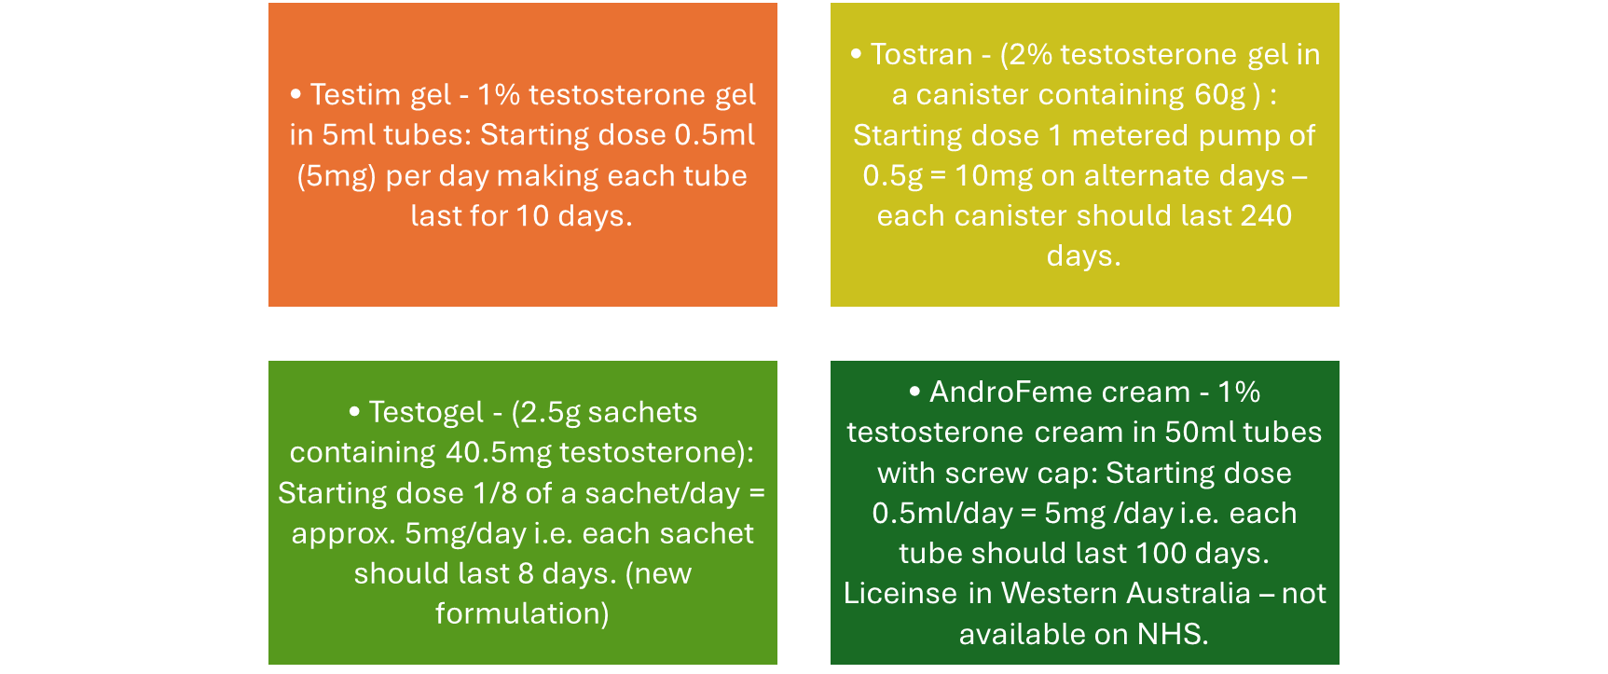
Products (Off License)
Notes:
Numerous studies have shown that adding testosterone to hormonal therapy can improve sexual function and general wellbeing among women during their menopause.
Testosterone supplementation improved several domains of sexual response including sexual desire, pleasure, arousal, orgasm, and self-image
Additional benefits including the improvement of urogenital, psychological, and somatic symptoms, an increase in bone density, and enhancement of cognitive performance when combined with oestrogen as part of HRT – Evidence is limited
Further trial from the BMS and NHIR are underway in this under researched area

Slide 31

Questions ?

Slide 32
Further reading:
Menopause Matters, menopausal symptoms, remedies, advice
Menopause - NHS (www.nhs.uk)
Women's Health Concern | Confidential Advice, Reassurance and Education (womens-health-concern.org)
Charity for Women with POI | The Daisy Network
British Menopause Society | For healthcare professionals and others specialising in post reproductive health (thebms.org.uk)
Menopause | Health topics A to Z | CKS | NICE
NOTE: Limited Evidence – This means that there is little significantly strong evidence for this therapy in context to given symptoms/benefits. And also unclear of long term effects. This does not mean this does not work, just that we cannot say from a statistical point of view it does.

Slide 33
References
AMS (2019) Testosterone and women. Australian menopause society. Available online at: Testosterone and Women - Australasian Menopause Society
British Menopause Society | For healthcare professionals and others specialising in post reproductive health (thebms.org.uk)
BMS (2022) Testosterone replacement in menopause. Available online at: 08-BMS-TfC-Testosterone-replacement-in-menopause-DEC2022-A.pdf (thebms.org.uk)
Burger (2002) Androgen production in women. Fertility and Sterility. Available online at: :https://doi.org/10.1016/S0015-0282(02)02985-0
Davis & Wahlin-Jacobsen (2015) Testosterone in women – the clinical significance. The Lancet: Diabetes and Endocrinology. Available online at: Testosterone in women—the clinical significance - The Lancet Diabetes & Endocrinology
DSCPG(2023) Menopause. Derbyshire Shared Care Pathology Guidelines. Available online at : Southern Derbyshire (uhdb.nhs.uk)
fsrh-guideline-contraception-aged-over-40-sep-2019.pdf
Guidance on management and prescribing HRT for GPs | Primary Care Women's Health Forum (pcwhf.co.uk)
JAPC (2023) Menopause management guideline. Available online at: Menopause_Guideline.pdf (derbyshiremedicinesmanagement.nhs.uk)
MHRA HRT risk table. Available online at: Table1.pdf (publishing.service.gov.uk)
The Menopause Charity - Menopause Facts, Advice and Support
Menopause Matters, menopausal symptoms, remedies, advice
Menopause | Health topics A to Z | CKS | NICE
Menopause - NHS (www.nhs.uk)
Hormone replacement therapy (HRT) | MIMS online
NHS (2023) Free Androgen Index. Gloucestershire Hospitals. Available online At: Free Androgen Index (FAI) (gloshospitals.nhs.uk)
Testosterone in women—the clinical significance - The Lancet Diabetes & Endocrinology

